Slide 1
Meet the teacher 2024-25
Birch Year 1

Slide 2
Personal Details
Ensure the office has up-to-date
details for your child.
Address
Emergency contact numbers – two numbers needed
Email address
Medical information

Slide 3
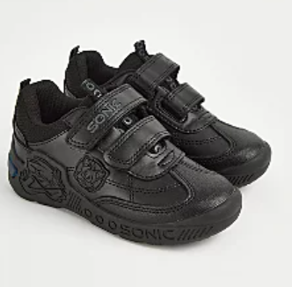
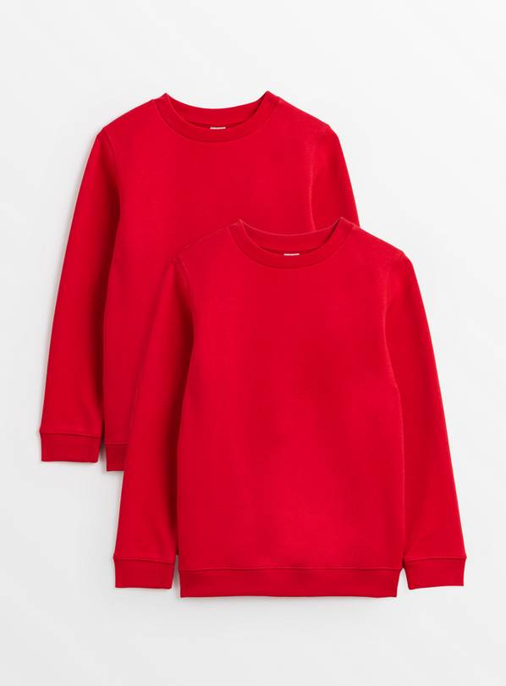
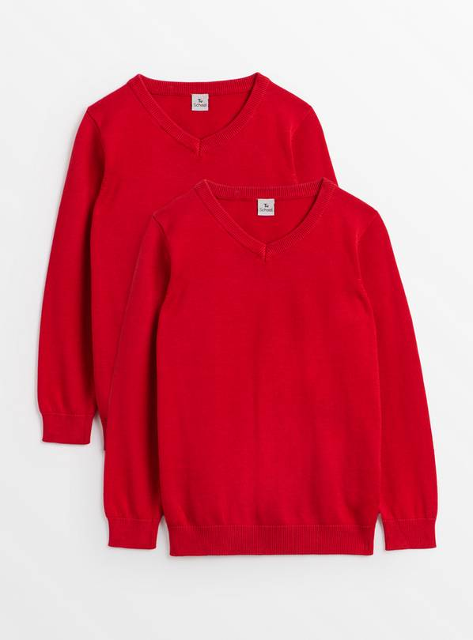
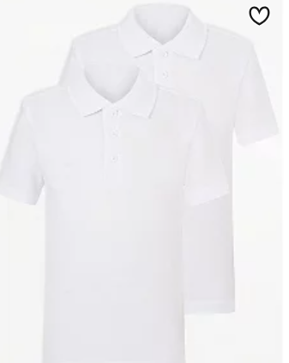
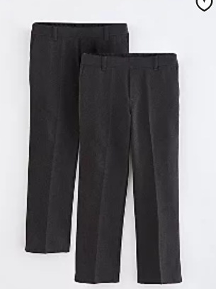
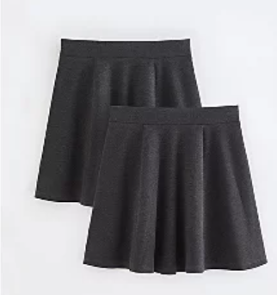
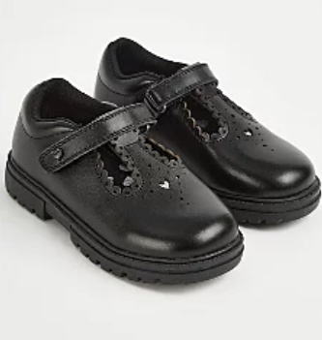
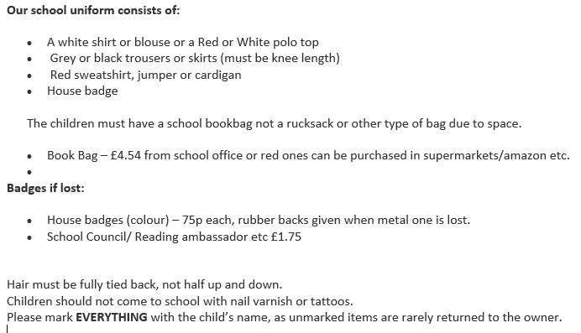
School Uniform
Notes:
Jewellery/hair accessories – red headbands

Slide 4
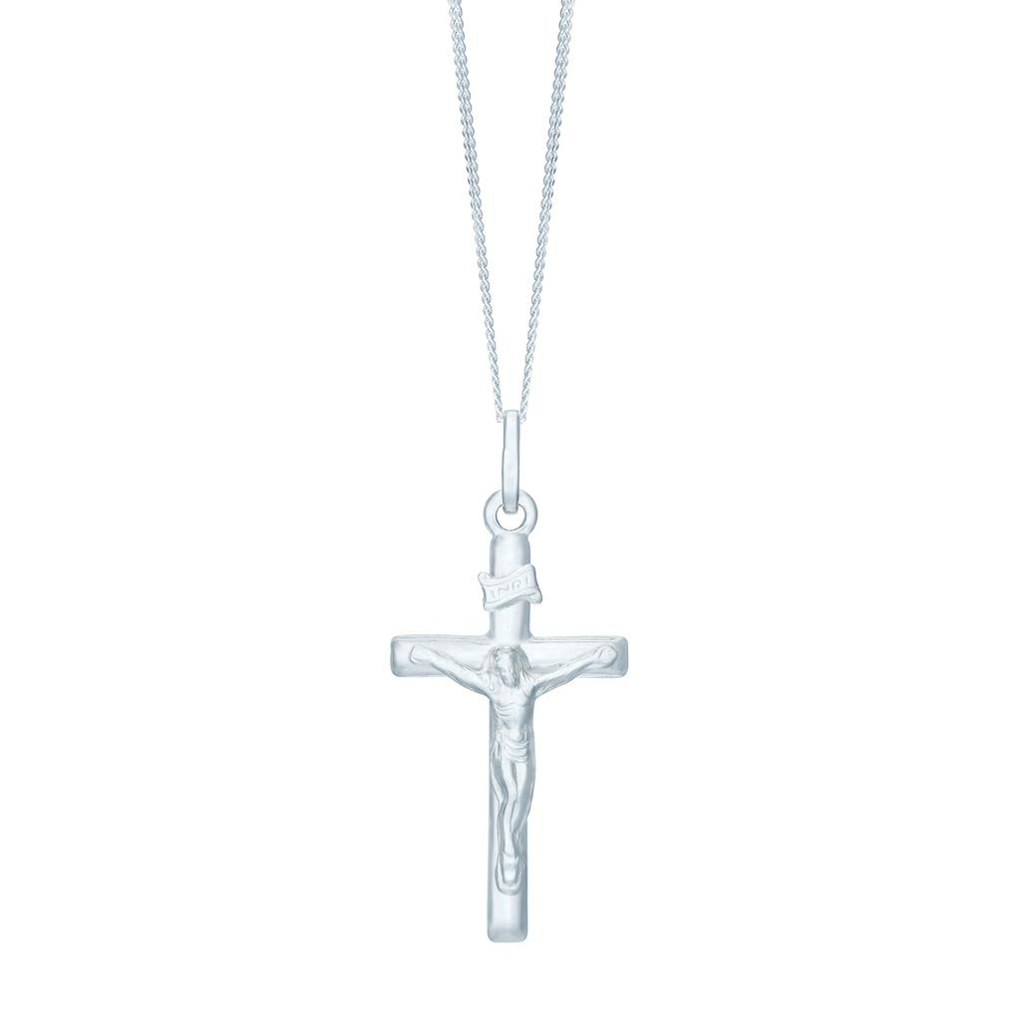
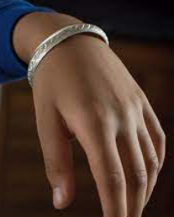
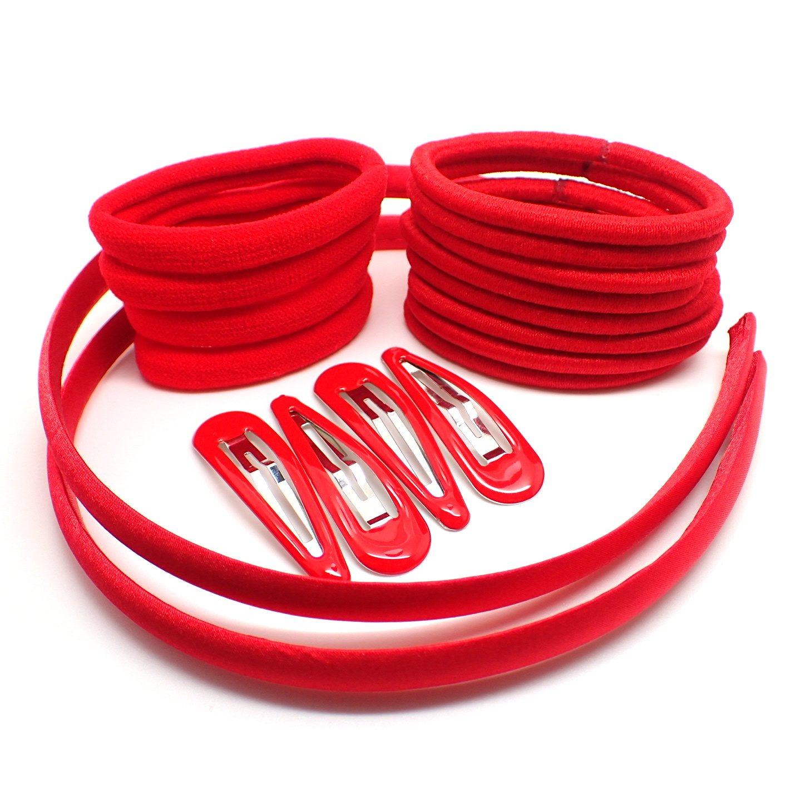
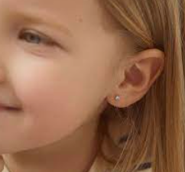
Jewellery
For safety, no jewellery is the best option.
We allow:
Compulsory religious jewellery
Red, black. White or grey simple hair accessories
Small studs

Slide 5
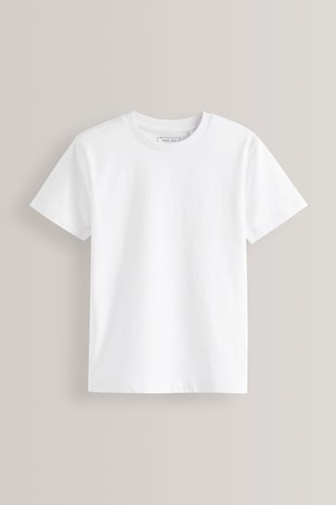
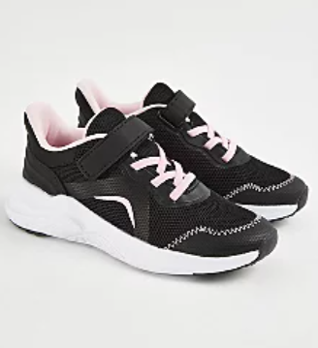
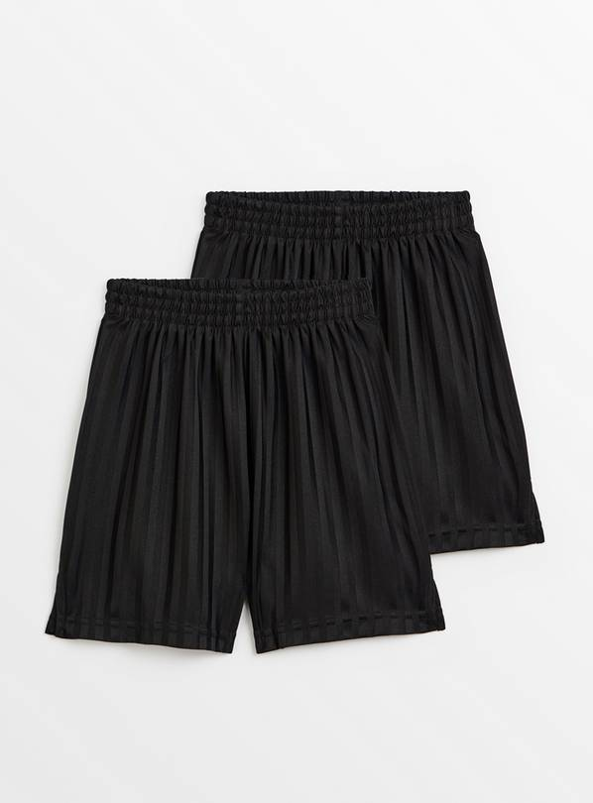
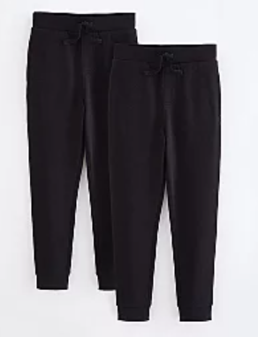
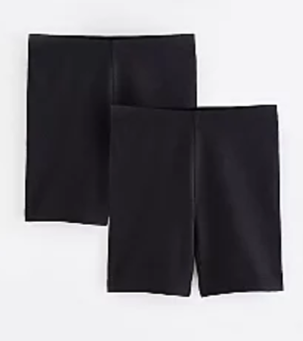
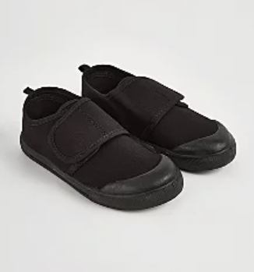
PE Uniform

Slide 6
PE
PE lessons will take place every Tuesday and Friday
We cannot change for PE so on these days you will need to wear your PE kit to school.
Plain black shorts, plain white Tshirt.
School jumper or black fleece
No football tops
No blades or studs trainers

Slide 7
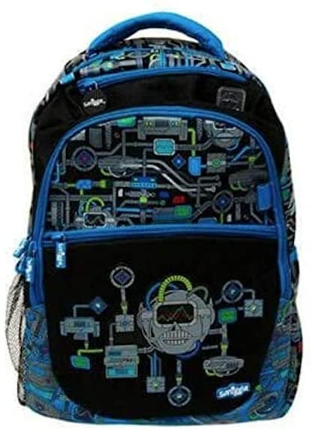
Things your child needs to bring
Red book bag
A named, filled water bottle from home every day.
Lunch box if pack lunch.
Please remember to order your child’s food on school grid. If you forget they will be given a cheese roll.
All equipment will be provided. Please do not send in items from home.
✔

Slide 8
Attendance and Punctuality
It is vital that you come to school every day and on time.
Doors open at 8.20am
They close at 8.30am and children will be working straight away.
Please ensure you are collecting your children on time from the playground at 3pm. Please do not come down to the door.

Slide 9
Curriculum
Our History topic this term is about the explorers Christopher Columbus and Amelia Earhart.
In art we will be using printing techniques, looking at pop art and the artists Roy Lichtenstein and Andy Warhol.
In science we are learning about ourselves. How we change over time and our senses.

Slide 10
Reading
You will be expected to read for at least 20 minutes at least three times a week, but ideally every day. This should be their banded reading book.
An adult needs to fill in their reading record every time they read with any words they found difficult, the page they read to and sign it.
Children’s book bands are determined upon performance in class and on assessments.
Books will be changed at the discretion of the class staff as children need to be able to read the book fluently first.

Slide 11
Home Learning
Reading – Banded Books
Maths – games related to the current teaching. Set as and when. Usually on maths frame.
Times Tables Rock Stars – minimum of 20 minutes a week.
Weekly spellings (based on the weeks spelling rules) – given out every Friday for a test the following Friday.
Common Exception Word spellings – tested half termly so ongoing revision required.

Slide 12
School website (click on link)any communication with children’s learning will appear on here

Slide 13
Making appointments to see your child’s teacher
If you need to discuss something brief with us please come and speak to us when you collect your child at the end of the day. If you are going to need a longer amount of time, then please arrange an appointment via the school office or with the teacher at collection time.
Appointments with a class teacher in a morning need to be before 8:30am. Teachers are supervising pupils as of 8:30am.
Updating you on your children's progress – we will do this through our parents meeting and reports. If you have concerns then please do come and discuss with us.

Slide 14
Trips
A parent calendar of key dates will be released for each term on the newsleetter
Teachers to inform parents of likely trips for the year
Potential costs
Explain how parent helpers are selected

