Slide 1
Meet the teacher
Class teacher - Miss Layman
Class TA - Miss Marsh

Slide 2
Personal Details
Ensure the office has up-to-date
details for your child.
Address
Emergency contact numbers – two numbers needed
Email address
Medical information

Slide 3
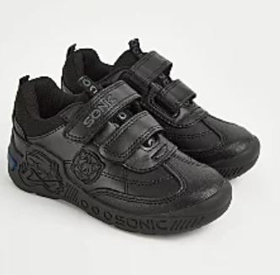
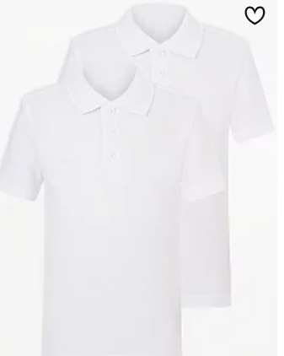
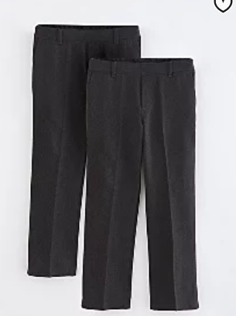
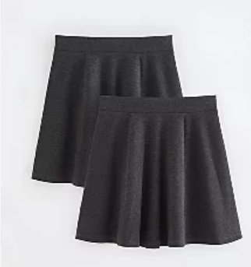
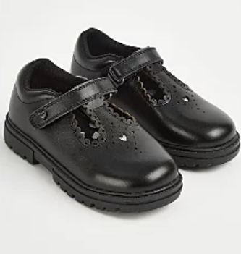
School Uniform
School Uniform
A white shirt or blouse or a Red or White polo top
Grey or black trousers or skirts (must be knee length)
Red sweatshirt, jumper or cardigan
House badge
Children in KS2 wear ties which can be purchased from the school office
Further information is available on the school website
Notes:
Jewellery/hair accessories – red headbands

Slide 4
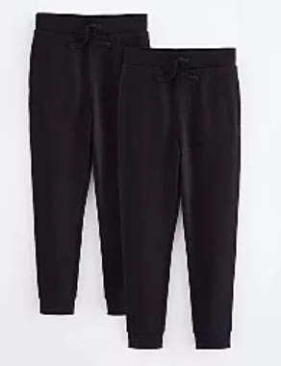
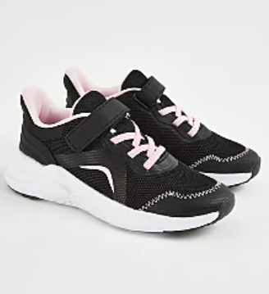
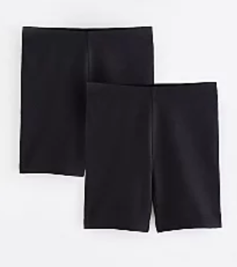
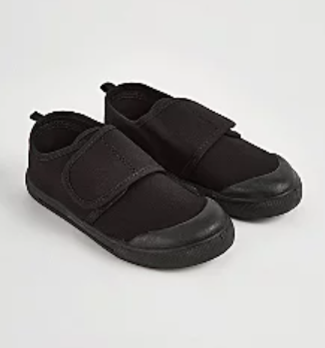
PE Uniform
No hoodies
No football tops
No blades or studs trainers
White T-Shirts, black bottoms and an outer layer for outdoor PE

Slide 5
PE
PE lessons will take place on Mondays and Thursdays.
We cannot change for PE, so on these days children will need to wear PE kits to school.
  White t-shirt
  Black Jogging bottoms, leggings or shorts
  Trainers
  School jumper to be worn during school day

Slide 6
Jewellery and Personal Items
For safety reasons, jewellery and other items of value should not be brought into school. If your child has pierced ears, only small studs are permitted and either must be removed or covered by micropore tape for PE lessons.
Discrete watches (not Smart watches) may be worn but we cannot accept responsibility if they are misplaced or broken.
Mobile phones are only permitted for pupils who walk home on their own (office and teacher must be made aware of children who are doing this). The phones MUST be switched off as soon as the child enters the school premises and must only be switched on when off school premises.
The child must hand their phone to their class teacher/teaching assistant when coming into class, the phones will then be put away until the end of the day and returned to the children on their way out of school.
Due to restricted premise facilities, the school cannot take responsibility for mobile phones.

Slide 7
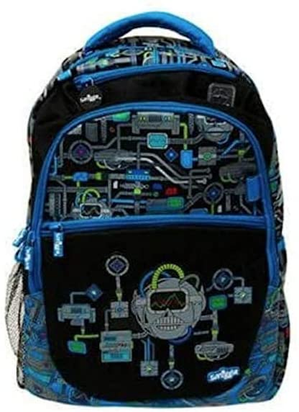
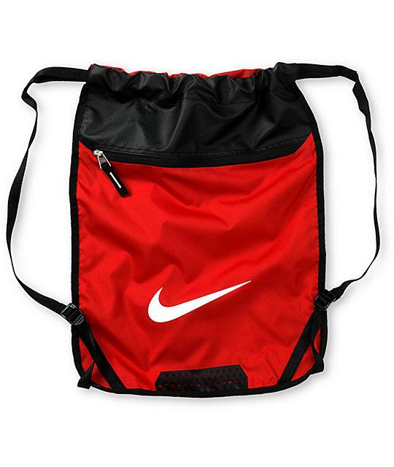
Things your child needs to bring
A waterproof bag that can hold home learning books (A4 size) and reading books.
Bulky back packs are not allowed as we cannot use the cloakrooms to store these items.
Do not bring a pencil case from home - all equipment will be provided by school.
Children MUST bring a labelled water bottle, of no more than 500ml every day.
✔

Slide 8
Attendance and Punctuality
It is vital that children come to school every day and on time.
Soft start begins at 8:20am – this is when classroom doors will open.
The register will close at 8:30am– this is when classroom doors will close, and children will need to enter the school via the office. They will then be entered as late.
Please ensure you are collecting your children (unless they walk home themselves) on time from the KS2 playground at 3:00pm.

Slide 9
Curriculum
An overview of objectives or topics covered this half term
Maths – Place value
English – Fiction, Non-Fiction, Poetry
Science – Living Things and Their Habitats
History – Ancient Egyptians
Further information on all subjects is available on the school website.

Slide 10
Reading
Children are expected to read at least 3 times a week.
Details of this should be entered into their reading record and signed/dated by an adult.
Children are encouraged to note any new vocabulary they’d learnt or/and summarise their thoughts on what they have read.
9/9/2024 Star Light p.5-25 | Vital – extremely important Treacherous – very dangerous The impression I get of the witch is that she is old because ‘her withered hand’

Slide 11
Home Learning
Weekly Home Learning will be set in each class to be returned the following week.
It is important that Home Learning is completed and returned on the date specified.
A signed note from an adult is required if there is an issue with the above.

Slide 12


