Slide 1
Meet the teacher 2024-25
Laurel Year 3

Slide 2
Personal Details
Please ensure the office has up-to-date details for your child:
Address
Emergency contact numbers – two numbers needed
Email address
Medical information

Slide 3
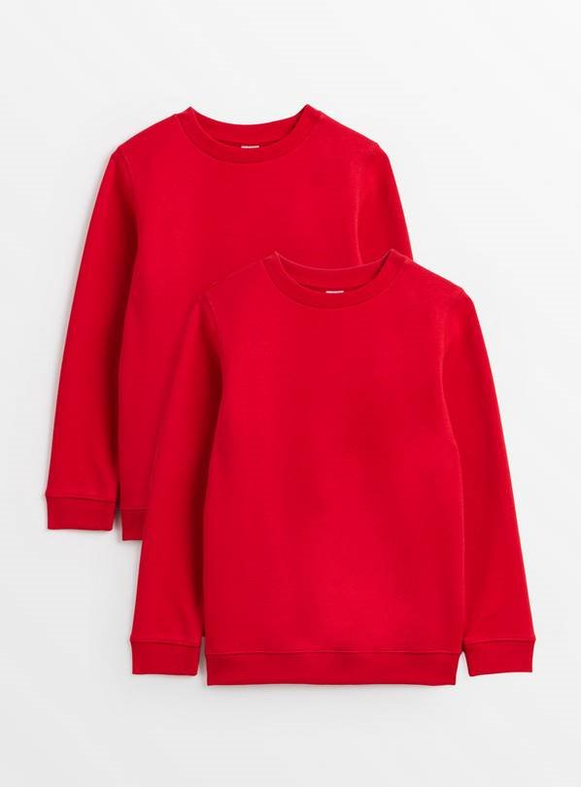
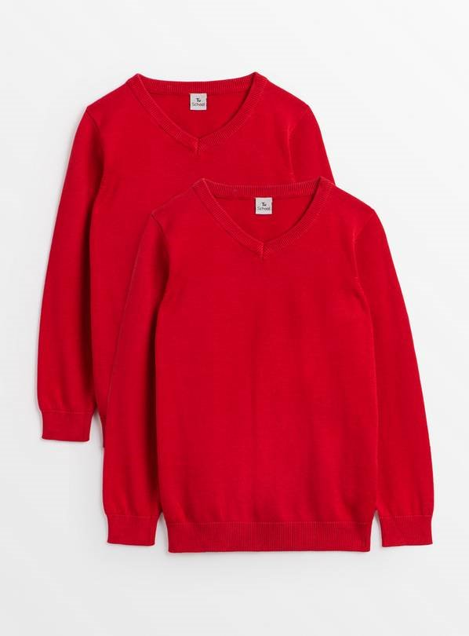
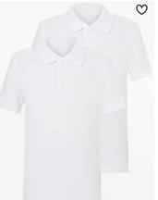
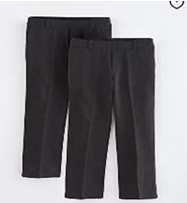
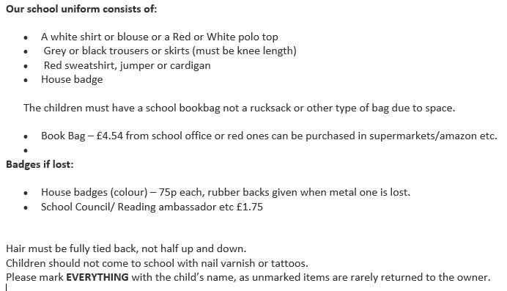
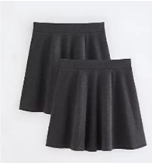
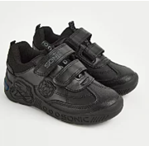
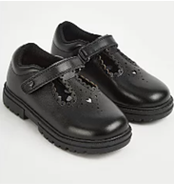
School Uniform

Slide 4
Jewellery
For safety, no jewellery is the best option.
We allow:

Slide 5
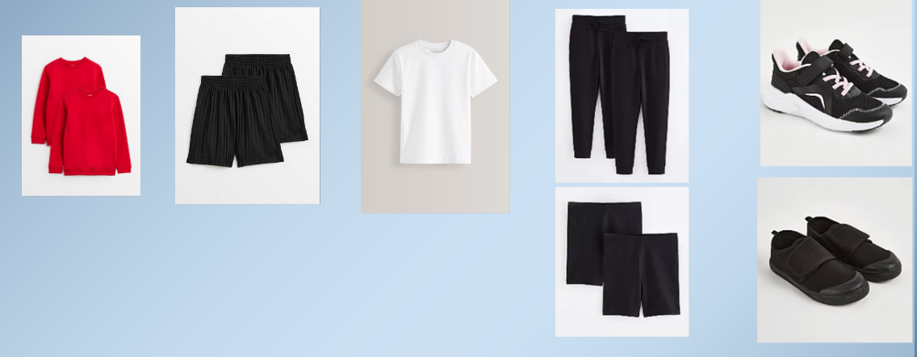
PE Uniform

Slide 6
PE
PE lessons will take place every Monday and Wednesday.
We cannot change for PE so on these days you will need to wear your PE kit to school.
Plain black shorts, plain white T-shirt.
School jumper or black fleece
No football tops
No blades or studs trainers

Slide 7
Things your child needs to bring
Red book bag
All equipment will be provided. Please do not send in items from home.
A named, filled water bottle from home every day.
Lunch box if pack lunch.
Please remember to order your child’s food on school grid. If you forget they will be given a cheese roll.

Slide 8
Attendance and Punctuality
It is vital that you come to school every day and on time.
Doors open at 8.20am
They close at 8.30am and children will be working straight away.
Please ensure you are collecting your children on time from the playground at 3pm. Please do not come down to the door.

Slide 9
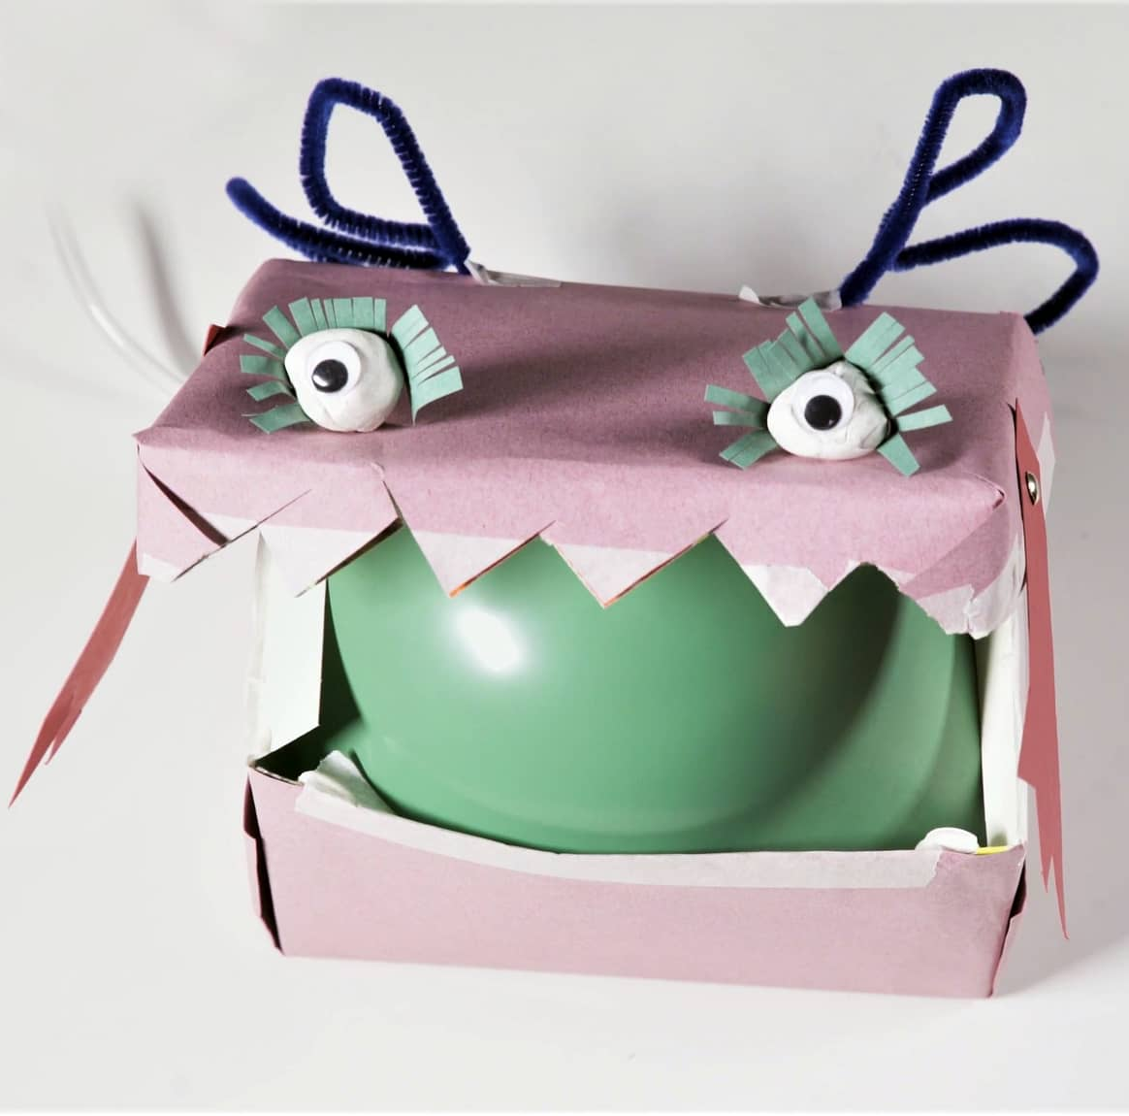
Curriculum
In History and Geography this term we will be learning about our local area and Hemel Hempstead.
In art we will be using sketching techniques, looking at famous sketches by Leonardo Da Vinci and recreating some of his famous work.
In science we are learning about animals, including humans. We will specifically be looking at movement and feeding (i.e. healthy eating).
In DT will be exploring mehanisms, specifically pneumatic toys. We will be making our own pneumatic toy.

Slide 10
Reading
You will be expected to read at least three times a week at home, but ideally every day. This should be their banded reading book.
An adult needs to fill in their reading record every time they read with any words they found difficult, the page they read to and sign it.
Children’s book bands are determined upon performance in class and on assessments.
Books will be changed at the discretion of the class staff as children need to be able to read the book fluently first.

Slide 11
Home Learning
Reading – Banded Books
Times Tables Rock Stars – minimum of 20 minutes a week.
Weekly spellings (based on the weeks spelling rules) – given out every Friday for a test the following Friday.

Slide 12
Making appointments to see your child’s teacher
If you need to discuss something brief with us please come and speak to us when you collect your child at the end of the day. If you are going to need a longer amount of time, then please arrange an appointment via the school office or with the teacher at collection time.
Appointments with a class teacher in a morning need to be before 8:30am. Teachers are supervising pupils as of 8:30am.
Updating you on your children's progress – we will do this through our parents meeting and reports. If you have concerns then please do come and discuss with us.

Slide 13
Trips
A parent calendar of key dates will be released for each term on the newsletter
Teachers to inform parents of likely trips for the year
Potential costs

