Slide 1
Meet the teacher 2024-25
Willow Year 3/4

Slide 2
Who’s who?
Mrs Young
Miss Trinnaman
Mrs Waryszniuk

Slide 3
Personal Details
Ensure the office has up-to-date
details for your child.
Address
Emergency contact numbers – two numbers needed
Email address
Medical information

Slide 4
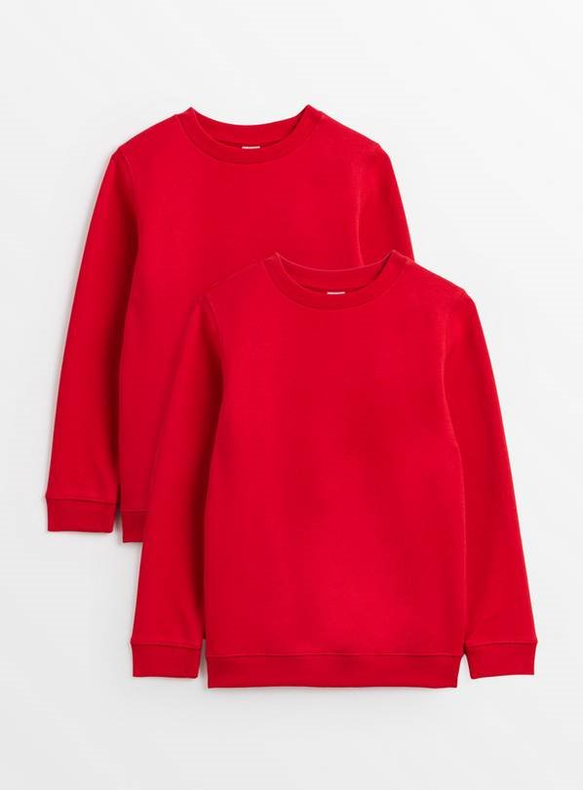
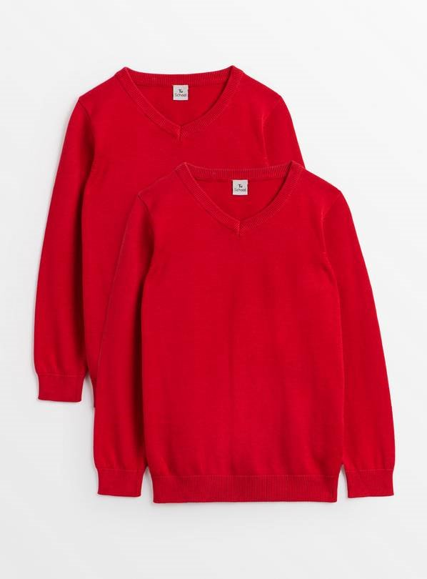
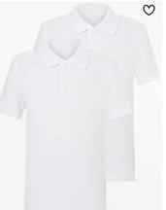
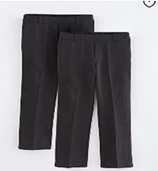
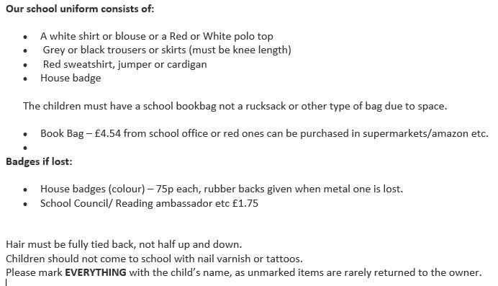
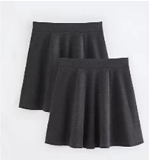
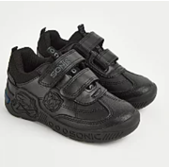
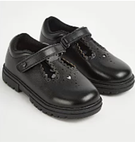
School Uniform

Slide 5
Jewellery
For safety, no jewellery is the best option.
We allow:

Slide 6
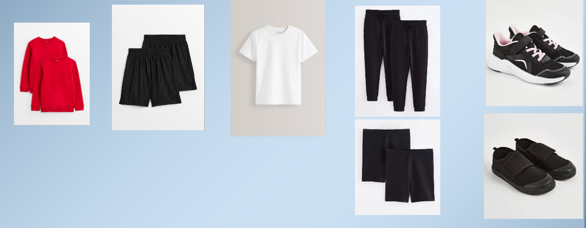
PE Uniform

Slide 7
PE
PE lessons will take place every Tuesday and Wednesday
Please come dressed for PE on the Tuesday as this is a 90 minute slot.
You do not need to come dressed for PE on a Wednesday, as this is only a 30 minute slot.
Plain black shorts, plain white Tshirt.
School jumper or black fleece
No football tops
No blades or studs trainers

Slide 8
Things your child needs to bring
Red book bag
All equipment will be provided. Items do not need to be sent in from home.
A named, filled water bottle from home every day.
Lunch box if packed lunch.
Please remember to order your child’s food on school grid. If you forget they will be given a cheese roll.

Slide 9
Attendance and Punctuality
It is vital that you come to school every day and on time.
Doors open at 8.20am
They close at 8.30am and children will be working straight away.
Please ensure you are collecting your children on time at 3pm.

Slide 10
Curriculum
In science our focus is on ‘Movement and Feeding’. We will look at nutrition and eating a balance diet, what animals eat and skeletons, bones and muscles.
In history this term we will be learning all about Hemel Hempstead and how it has changed over time.
In art we will be creating observational drawings and portraits, looking at the artist Leonardo Da Vinci and some of his work. We will be using sketching pencils to focus on skills such as shading, line and texture.
In PE we will focus on hockey and gymnastics.
In computing we will look at computing systems and networks and creating media.

Slide 11
Curriculum
In French we will be learning to describe ourselves and others in class.
In music we will be learning to listen and appraise music, sing and play tuned instruments.
In RE this term, we will be looking at Christianity and Islam.
In PSHE we will look at ‘Being me in my world’ focusing on helping others, our school community and everyone’s right to learn.
In DT we will be looking at mechanisms and making pneumatic toys.
In Geography we will be looking at our town carrying out fieldwork and observations, looking at human and physical features and maps.

Slide 12
Reading
You will be expected to read for at least 20 minutes at least three times a week, but ideally every day. This should be their banded reading book.
An adult needs to fill in their reading record every time they read with any words they found difficult, the page they read to and sign it.
Children’s book bands are determined upon performance in class and on assessments.
Books will be changed at the discretion of the class staff as children need to be able to read the book fluently first.

Slide 13
Home Learning
Reading – Banded Books. Reading is an important part of the curriculum and enriches all other areas, supporting writing, extending vocabulary, improving fluency and should be seen as a priority. I would encourage reading to be completed daily and if the children read at least 3 times a week, they will get a hole punched in their punch cards. Once the children have completed this 10 times, they will be able to choose a prize.
Times Tables Rock Stars – Children will be set times tables to learn and should practice regularly. The year 4 children will have the Multiplication Tables check in June. The purpose is to ensure the times tables knowledge is at the expected level. The Multiplication Times Tables Check is an online test where the pupils are asked 25 questions on times tables 2 to 12. For every question, you have 6 seconds to answer, and in between the questions, there is a 3-second rest. Questions about the 6, 7, 8, 9, and 12 times table come up more often. The questions are generated randomly.
Weekly spellings will be given out based on the weekly spelling rules alongside some of the common exception words. These will be given out each week on a Friday and the children will be tested the following Friday.
Additional homework may be given out on occasions to support other areas of the curriculum.

Slide 14
Making appointments to see your child’s teacher
If you need to discuss something brief with us please come and speak to us when you collect your child at the end of the day. If you are going to need a longer amount of time, then please arrange an appointment via the school office or with the teacher at collection time.
Appointments with a class teacher in a morning need to be before 8:30am. Teachers are supervising pupils as of 8:30am. I am happy to meet with you after school, but will not be able to do this on a Tuesday due to staff meetings/training.
Updating you on your children's progress – we will do this through our parents meeting and reports. If you have concerns then please do come and discuss with us.

Slide 15
Trips
A parent calendar of key dates will be released for each term on the newsletter
Teachers to inform parents of likely trips for the year and potential costs

